Slide 1
Woodland Public Schools
Facilities and Safety Report
August -September 2020

Slide 2
FACILITIES REPORT
COVID-19
Elementary Start-up We are very excited to have our elementary schools starting soon. It will be great to see kids in the classroom again! In the next week, we will be finishing the student quarantine area at Columbia and disbursing the thousands of PPE supplies to keep students and staff safe while we repopulate the schools. Initially, it will be challenging teaching our younger students how to wear masks and physically distance from their friends. When we started WCC at Columbia, I was pleasantly surprised how quickly the students adapted to the social distancing and mask wearing.
Attestations The online attestation program Steve Rippl and his team created and implemented for staff is running flawlessly. Both HR and Safety receive the positive results each morning. HR makes contact with the employee and Safety contacts the Department of Health for guidance on trace testing and protocol on positive Covid cases. The next evolution of the program will be to start student attestations. This will be a little more challenging as we will expect many more positive attestations due to the normal cold and flu season. Since most Covid symptoms are also present in just about every cold or flu virus, this will keep the admin and school nurses quite busy every morning.
Physical Distancing All classrooms in the District were measured, then laid out in AutoCad, to optimize physical distancing in each room. It was necessary to field measure each room so that unique architectural and built in furniture could be accounted for when laying out the rooms. In some cases, inches made the difference in student room capacity numbers.

Slide 3
FACILITIES REPORT
Water Works We are finishing up with the last bottle fill station at WMS. The District was awarded just under $39k from the OSPI Urgent Repair Grant Program. These dollars were requested to replace the section of piping from Park Street to the buildings on the north side of the Middle School campus. This pipeline appears to be original to the school’s auditorium, gym and CTE buildings. All of the other water lines for the Middle School green and yellow halls were replaced during the 1993 remodel. Our department will also be doing some of the piping work to maximize these grant dollars. The piping work should be finished within the next two weeks.
Earthquake Survey We are still moving forward with the DNR earthquake study. This site work is complete for the Middle, Columbia and Yale schools. The first part of the seismic study was to install sensors over a 150 yard area of field between CES and WMS. By installing these sensors and applying seismic forces to the ground, they are able to evaluate the “liquefaction effect” of the soils under our schools. They are currently examining this data along with the information they obtained during the site visit and drawing review. The next part is to take all of the data and apply it to a model that will help engineers understand how our schools will respond under different earthquake loads.

Slide 4
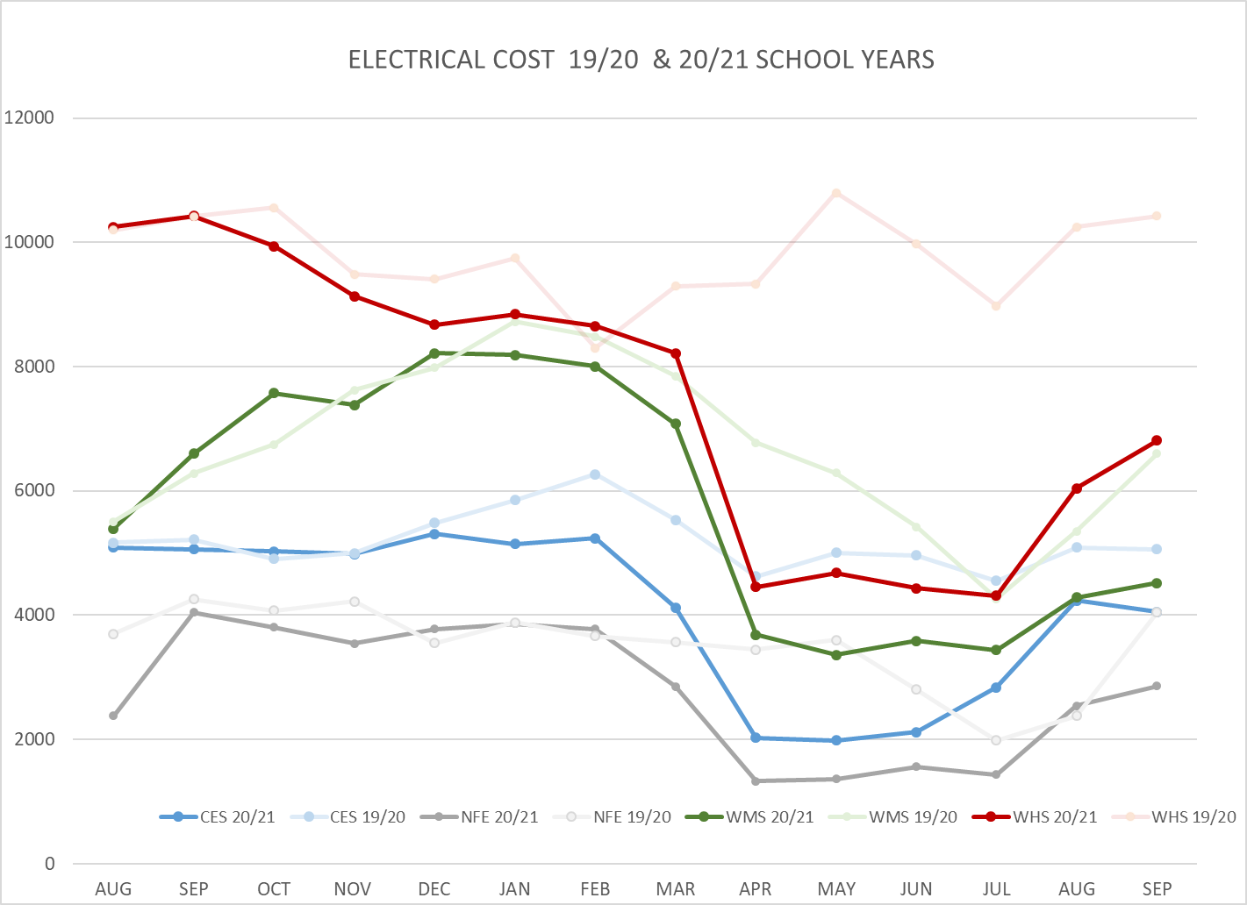
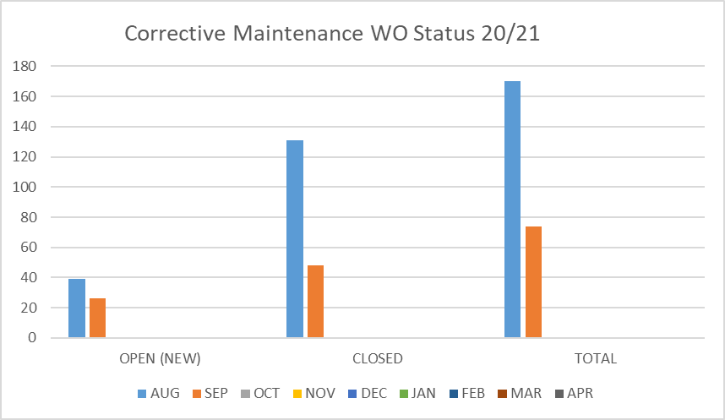
FACILITY CHARTS – POWER COST AND WORK ORDER STATUS

Slide 5
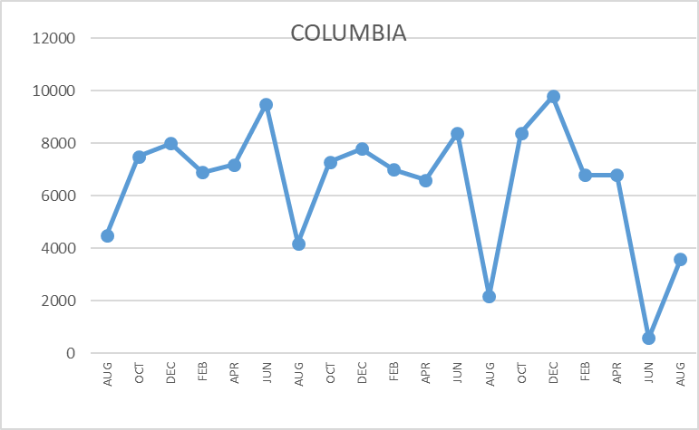
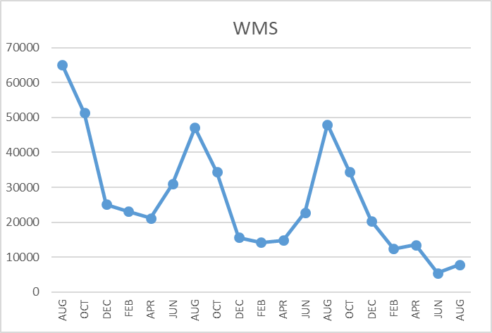
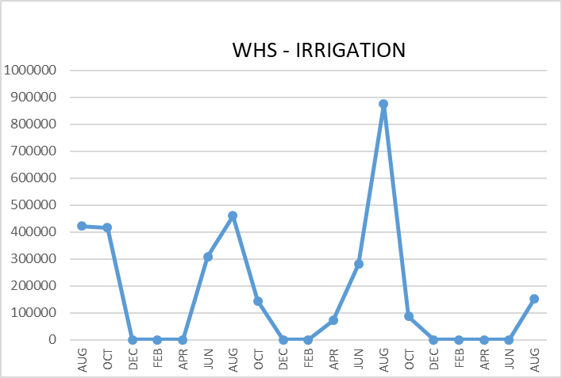
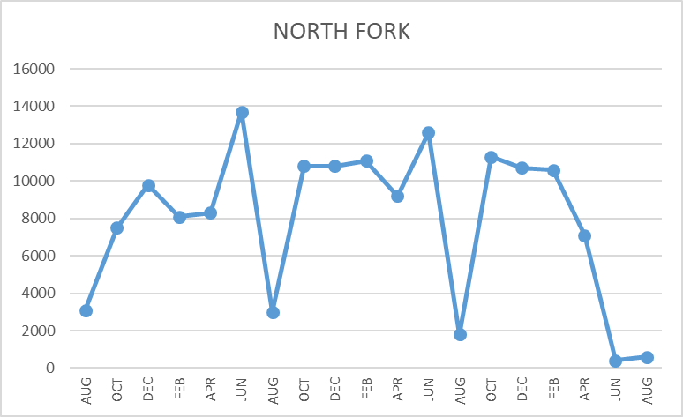
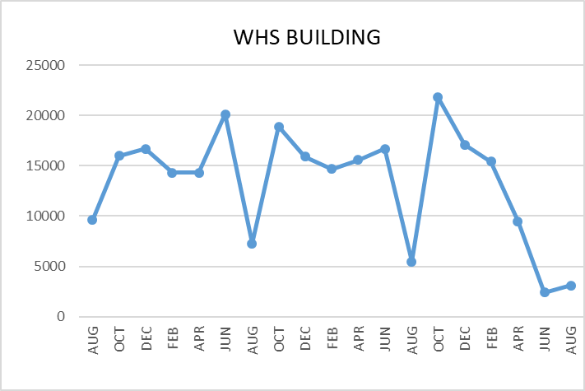
FACILITY CHARTS WATER USAGE WHS, NFE, WMS, CES
Note
Water charts are updated every two
months. Next update to these charts in the November 2020 report.
The WMS chart includes the following 7 meters: 755 Park high and low flow, BO and Team High, PIT house, bus barn, athletic field and DO. All of these meters are totaled on the WMS graph, but each data point is recorded separately to aid in identifying leaks.

Slide 6
Safety Summary
Staff Accidents/Incidents
No staff accidents or incidents recorded.
Student Accidents/Injuries
No student accidents or incidents recorded.
Covid info
We have had a handful of positive Covid cases in the schools. In each case, I partner with the Health Department for guidance on trace testing and quarantining of employees that may or did have close contact as defined by the CDC. HR has been recording the positive attestations and documenting conversations with the employees. We typically receive a handful of positive attestations each day that are related to regular illness, or in rare cases, a positive Covid case. The good news is, it appears that our internal protocols are working. No employees have been infected from other employees that have tested positive.

